Slide 1


Police and Crime Commissioner Elections 2024
Familiarisation Day – presentations
18th April 2024

Slide 2
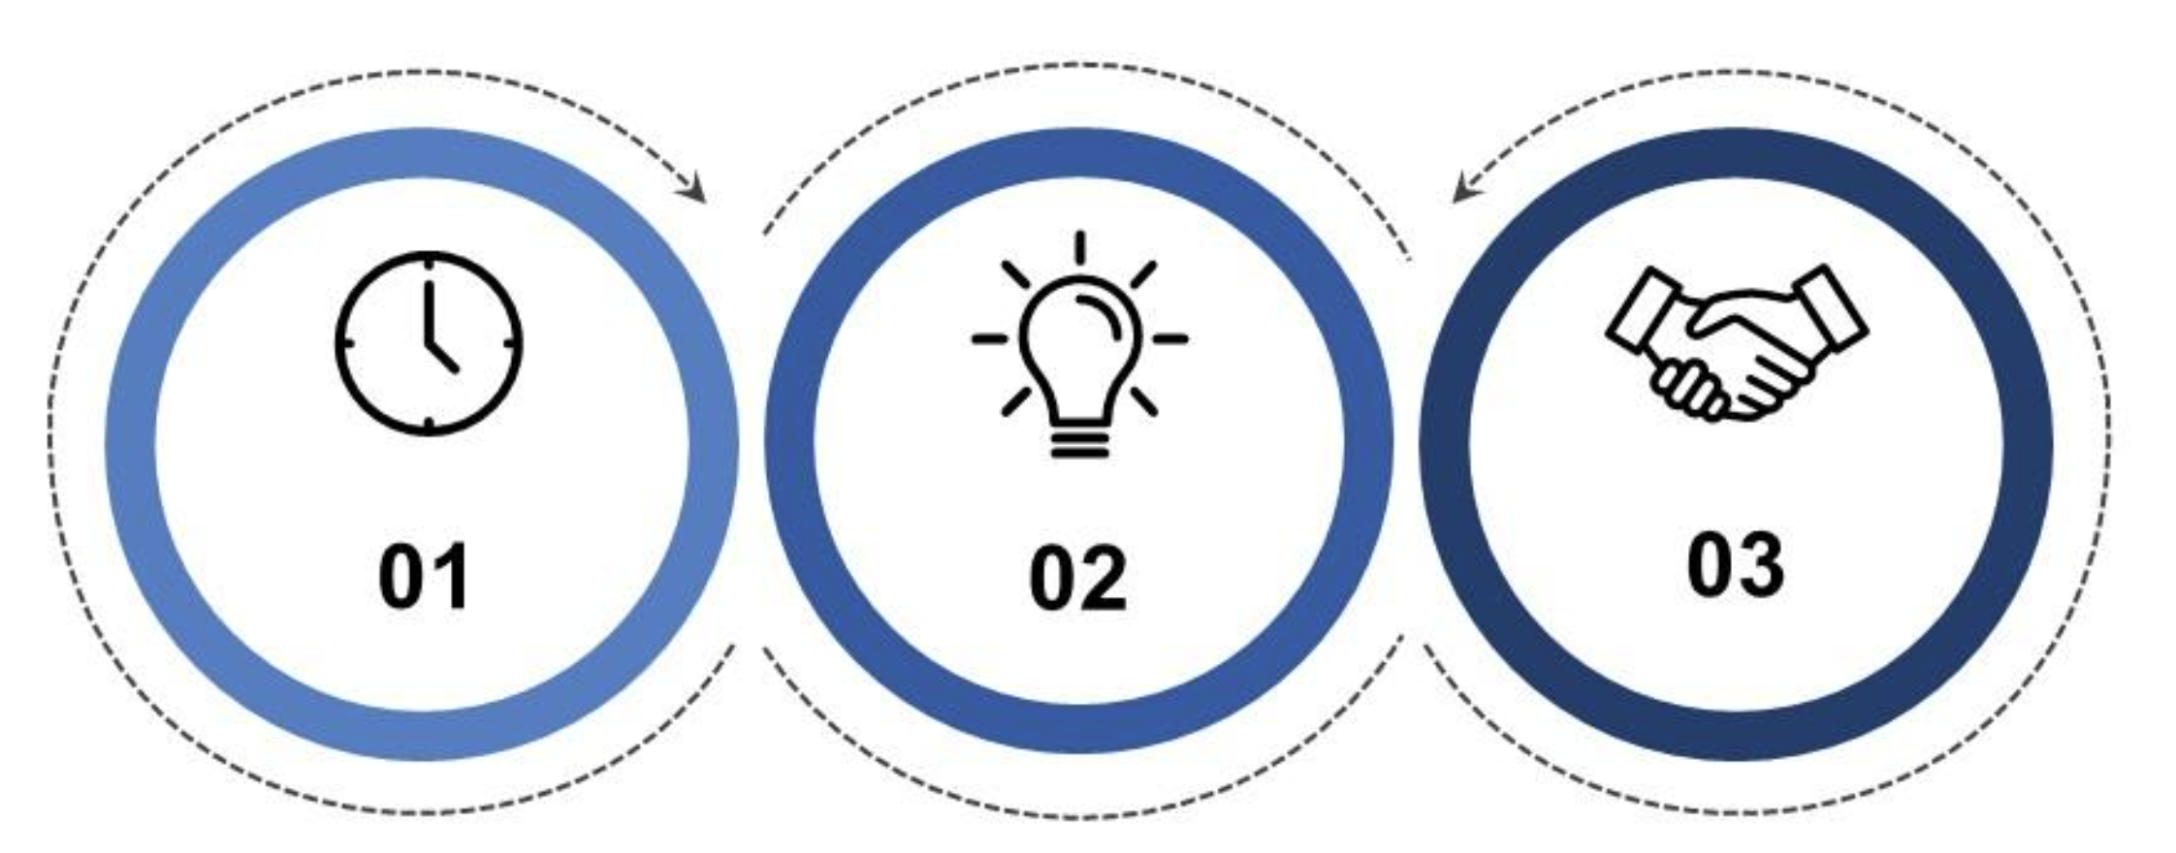
Welcome – Chief Constable Nixon, Claire Trewartha
To brief the PCC Candidates on the areas of focus and strategic direction for Leicestershire Police
Discuss the role of the PCC with aligning priorities with the Police and Crime Plan.
Inform the candidates of the plans to deliver an effective, efficient and legitimate police service for Leicester, Leicestershire and Rutland.

Slide 3
Housekeeping
Facilities; tea, coffee, toilets
No fire alarm scheduled today, door at the back of the room and follow COT/member of the OPCC
Slides will be shared on the PCC Elections dedicated webpage
Any questions will be recorded and logged on the electronic register to ensure transparency with other candidates
Candidates pack – provided and electronic copy will be published on the webpage

Slide 4
Statutory Functions of the OPCC

Slide 5
The Office of the Police and Crime Commissioner
‘The role of the OPCC is to support the statutory functions of a PCC, with a key focus on supporting delivery against the local Police and Crime Plan.’
APCC
Supporting the discharge of the statutory PCC functions
Enacting and delivering the PCC’s vision
Commissioning the PCC’s Statutory Responsibilities

Slide 6
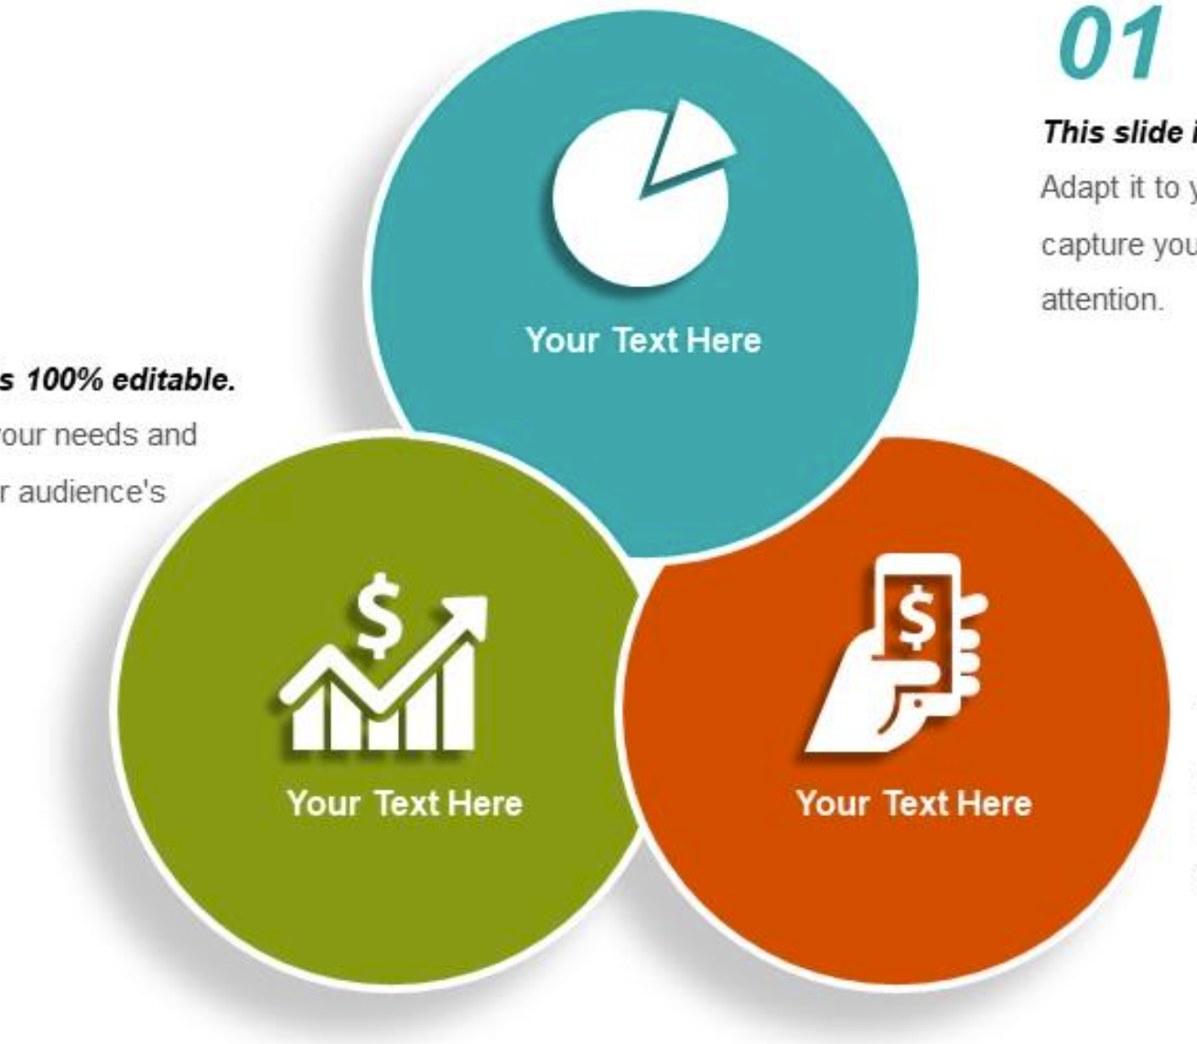

Key Legislation
Police Reform and Social Responsibility Act 2011
Policing Protocol 2023
Police Act 1996

Slide 7
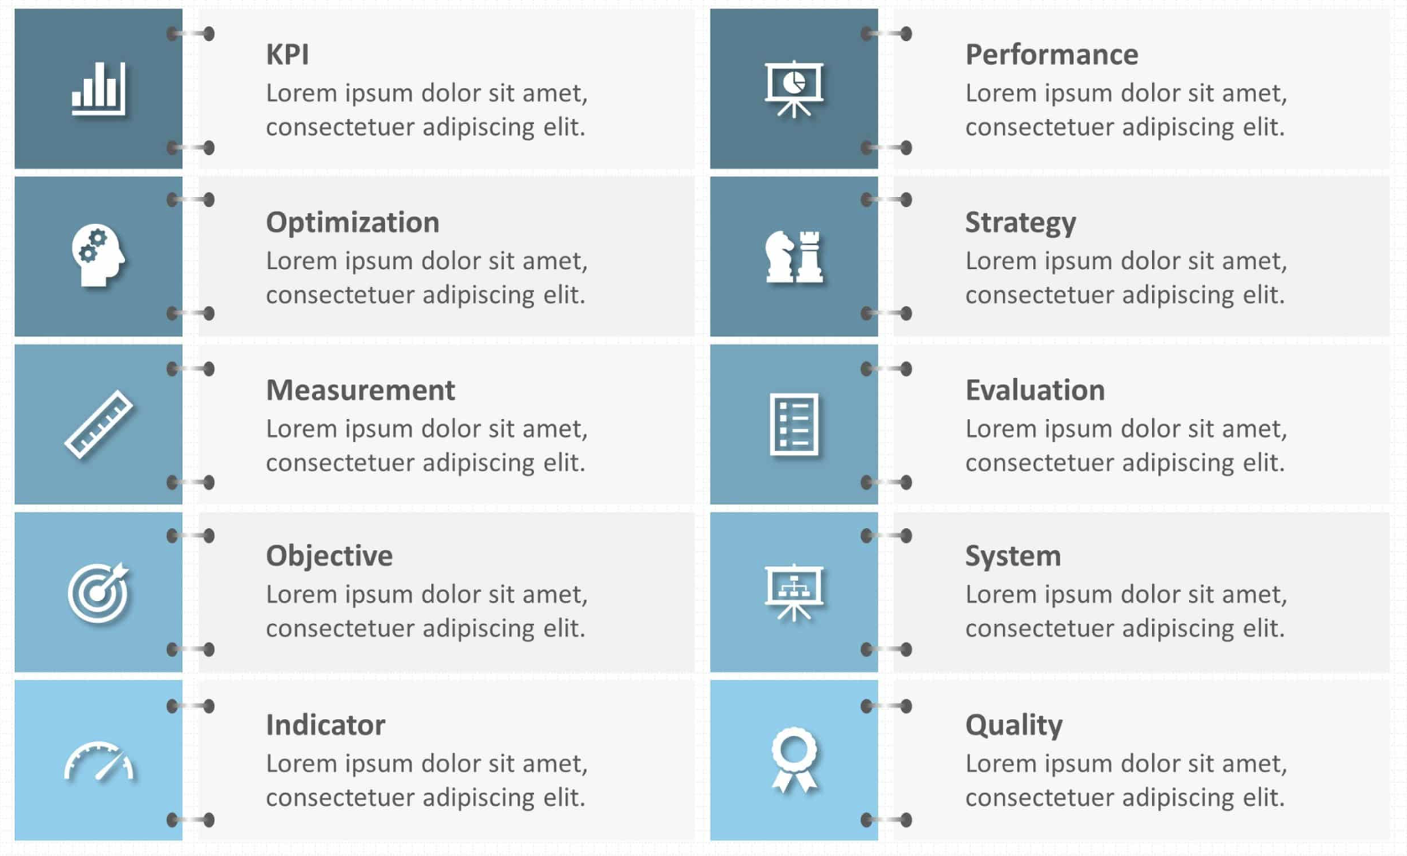
Holding the Chief Constable to Account
Setting a police and crime plan
Commissioning Services for Victims
Balancing local need and national priorities
Securing an Efficient and Effective Police Force
Determining precept and budgets
Providing a strong voice for the public
Complaint Review Body
Convening Partners to meet local priorities
Hiring a Chief Constable

Slide 8

Police and Crime Commissioner
Chief Executive and Monitoring Officer
Director of Governance and Performance
Chief Financial Officer
Director of Commissioning and Partnerships
Director of VRN
Head of Comms and Engagement
Setting a police and crime plan
Complaint review body
Holding the Chief Constable to account
Securing an effective, efficient police force
Determining precept and budget
Commissioning services for victims
Convening partners
Serious Violence
Engage with Public

Slide 9

Victim Services: Improving our offer
Siobhan Peters
Director of Strategy, Partnerships and Commissioning

Slide 10
Victim Services: Improving Our Offer
79.0%
Victim Satisfaction
86.5%
Compliance with Victims Code of Practice
Victims of crime deserve on outstanding response from both the OPCC and the Force.
Being a victim of crime or a witness to crime can be a traumatic experience.
Victims detrimentally impacted upon through long delays exasperated by the Crown Prosecution Service (CPS) processes, court back logs and prison capacity
This work needs to go alongside steps to prevent crime, including domestic abuse, sexual offences, exploitation, modern day slavery, hate crime and abuse of the elderly.

Slide 11
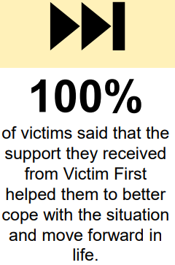
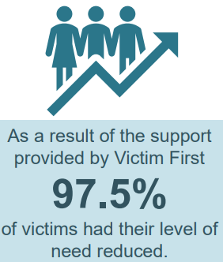
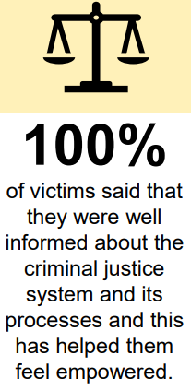
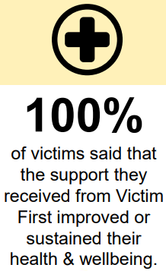
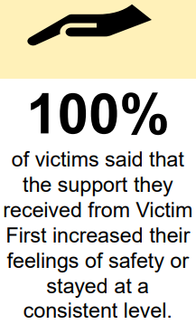
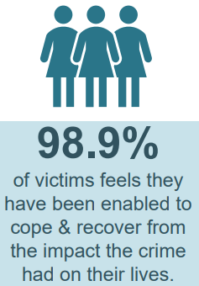
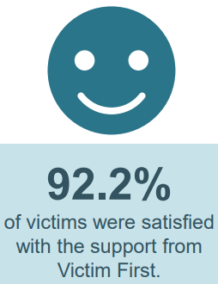
Commissioning a Service for Victims
Statutory responsibility to commission victim support services in their area and ensure victims have access to the support when they need it
The MoJ provides an annual grant to each PCC based on population. The grant covers the provision of general services for victims of crime, and some specialist services, such as domestic abuse and sexual violence. It also includes funds for the commissioning and coordination of Restorative Justice.
The grant for Leicestershire in 2024-25 is £1.279m

Slide 12
Improving our offer
Support the work of the Local Criminal Justice Board to further improve the performance in relation to victims
Lived experience built into the commissioning processes to strengthen approaches and impact
Review of Victims Bill and APCC Victims Working group to ensure in line with best practice
Develop an approach through commissioning to ensure support is reaching secondary victims
Funding a victim services pathway - an enhanced support mechanism where the standard support offered to victims is not sufficient for the victim
VOICES group – a consultation board of volunteer survivors of sexual violence
VCOP delivery group monitoring emergent issues such as consent and support for vulnerable victims
-

Slide 13

Serious Violence: Continuing Success
Grace Strong
T/Head of Prevention, Leicestershire Police
Director, The Violence Reduction Network

Slide 14
Serious Violence: Continuing Success
A Brief History….
In September 2019 we received Home Office funding to set up one of England and Wales first Violence Reduction Units (VRU). VRUs take a public health, preventative approach with the aim of understanding and tackling the causes of serious violence.
We called our VRU a Violence Reduction Network (VRN) to emphasise inclusivity and joint responsibility amongst communities and partners.
The Network is the whole partnership of groups, organisations and sectors but the OPCC also established a small, multi-disciplinary team to provide capacity and expertise.
Leicestershire Police received ‘Grip’ funding from 2019 onwards to tackle serious violence so that the VRU programme could focus more on prevention. We aligned our local Grip and VRN programmes to maximise co-ordination and impact.
Initially the VRN focused on public place serious violence with a priority focus on under 25 year olds. This work continues but we have since extended our scope to include serious violence relating to domestic abuse and sexual violence.

Slide 15






Serious Violence: Continuing Success
The Network’s Activity….
We use data and insights from multiple sources to understand the extent and nature of serious violence, the local prevalence of known causes and to monitor our impact.
We take a whole system approach and mobilise a broad range of partners, including young people and communities, to work together to prevent violence locally.
We ensure young people, parents/carers and professionals have the information they need to keep young people safe.
We design and roll-out evidence-based campaigns aimed at educating and mobilising the audience to play a role.

Slide 16

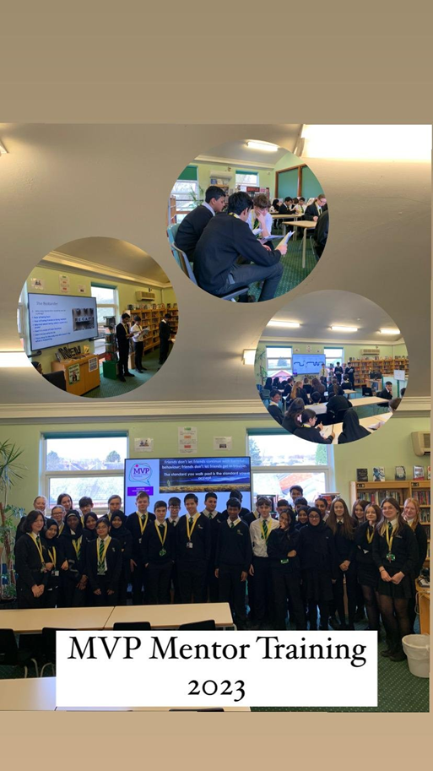
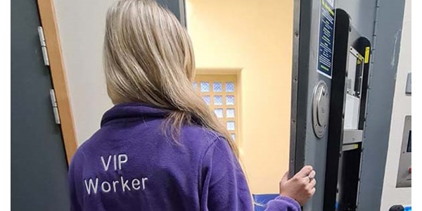
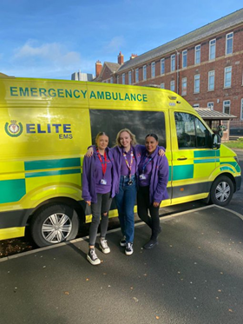



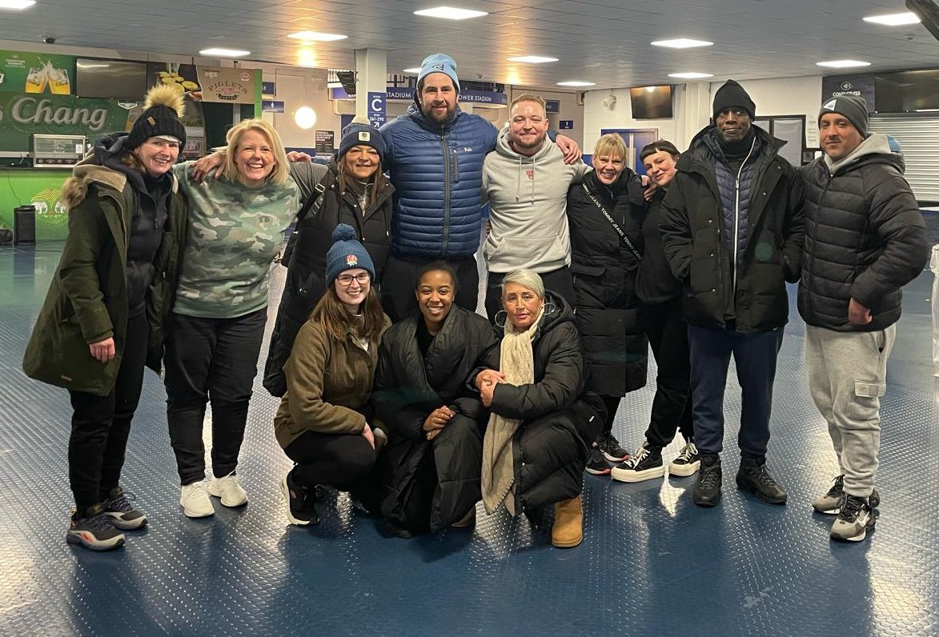
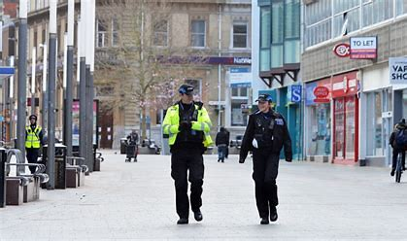

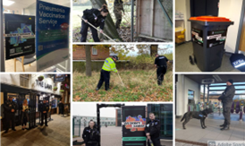

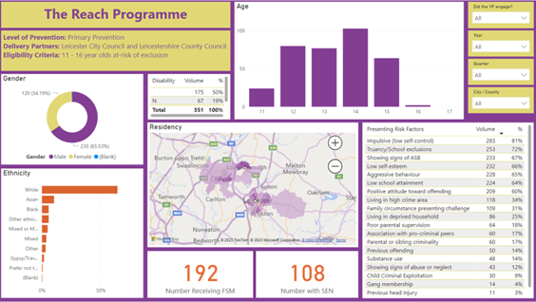
Serious Violence: Continuing Success
The Network’s Activity….
We design, pilot and evaluate evidence-based interventions in different settings to reach the right young people, at the right time and in the right way.
We deploy and monitor the impact of Criminal Justice responses to reduce serious violence.
We invest in monitoring and evaluation so we understand our impact and contribute to the local, national and international evidence of effectiveness.

Slide 17
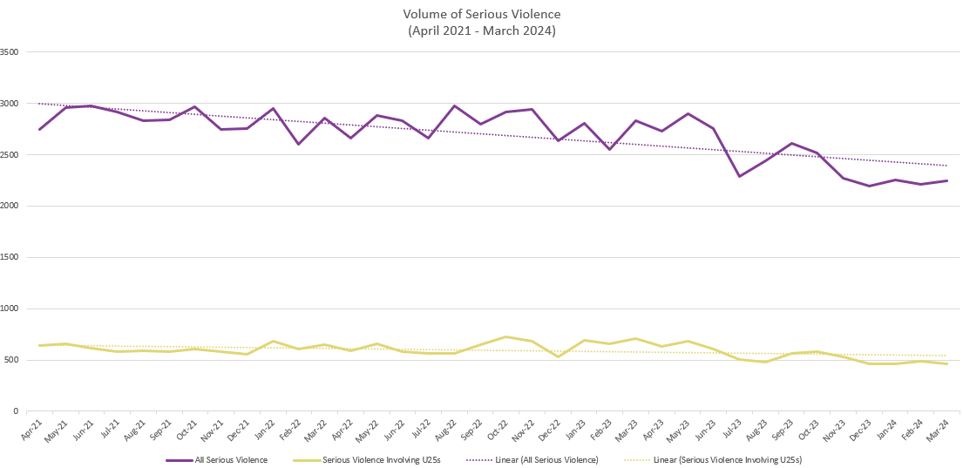
Serious Violence: Continuing Success
Examples of Success ….
We are experiencing reductions in serious violence locally and we received two ‘positive outlier’ letters for our performance.
We received ‘Mature, demonstrating best practice’, the highest rating in the Home Office’s readiness assessment for the SV duty and successfully led the work required throughout 2023-24 to meet all initial requirements of the Duty.
We have been subject to three positive national evaluations and our interventions are demonstrating promising outcomes for the young people and adults engaged in the programmes.
We secured £1.4 million funding from the Youth Endowment Fund for The Phoenix Programme and met all design and mobilisation requirements.
We successfully progressed the Reach Programme from efficacy trial to full implementation/evaluation securing an additional £1 million funding.
We led the national VRU Learning and Evaluation Network and held the first national Serious Violence Research and Evaluation conference.
However….
Some of the risk factors associated with serious violence have been increasing since the pandemic and resource challenges can compromise prevention.
Sustained reductions require a long-term, sustainable approach and a preparedness to continuously develop, learn and improve.

Slide 18

Prevention: Reducing Demand
Grace Strong
T/Head of Prevention, Leicestershire Police
Director, The Violence Reduction Network

Slide 19

Tracking & recording change and benefits delivery through layer boards
Based on data from our business cycle and Force Management Statement
  Layer 0 – Investment in IT solution with partners. Out of Court Disposals Review
  Layer 1 – Contact centre investment, Crime Bureau / Investigations Hub review
  Layer 2 – Systems aligned with Op Forefront investments
  Layer 3 – VAWG service, Digital Forensics, Redaction, national police database
  Layer 4 – Digital Case File, Custody Review, Medical Statements process
  Layer 5 – Cloud investment, data storage, capital prog, HR system upgrade
Plus IT interdependencies across the programme and service redesign linked to savings.

Slide 20

Prevention Directorate: Context and Rationale
The NPCC’s National Policing Prevention Strategy outlines the relevance, aims and enablers of prevention including the need to embed prevention as a core policing function and the importance of tackling the causes of crime, harm and demand through partnership orientated problem-solving.
This is now reflected in HMICFS’s PEEL Assessment Framework (Question 3)
Layer 0 (Prevention and Partnerships) was established as part of the Op Forefront transformational change programme.
Prevention has been included in Our Duty, The Leicestershire Police Pledge and Leicestershire Police’s Strategic Priorities in recognition that prevention plays a critical role in reducing crime, harm and demand now and in the future.
Leicestershire Police have a history of investing in prevention and partnerships including the former SHRU, VCCU and involvement in the VRN.
The aim of Layer 0 and the establishment of a Prevention Directorate is to strengthen this further. The Directorate brings prevention-focussed activity together under one Directorate with a common approach. It will directly deliver some activity whilst also offering strategic leadership, expertise and support across and beyond the Force so that prevention is embedded into policing and our partnerships.

Slide 21
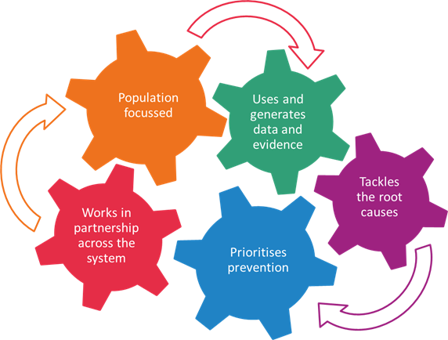

Prevention Directorate: Design and Delivery Principles
1
Use data and insights to understand the problem, its causes and to improve the targeting of resource
2
Draw on the evidence-base to ensure we are tackling the causes and maximising our effectiveness.
3
Prioritise and champion prevention to build commitment and secure a longer-term impact.
4
Work in partnership to make internal connections, jointly problem-solve and create comprehensive, effective solutions.
5
Involve victims and communities to improve relevance, legitimacy and satisfaction.
6
Invest in learning and development and technology to develop our expertise and improve services.
7
Monitor progress and evaluate our impact to continuously learn, improve and contribute to the evidence-base.

Slide 22

Prevention Model
Whole Population
Can be targeted
Primary Prevention
Preventing or minimising offending and harm in the first place
At Risk
Secondary Prevention
Preventing escalation through diversion and earlier intervention
Type
Repeats
Tertiary Prevention
Preventing or reducing reoccurring offending and harm
Focus
Universal
“For all”
Targeted
“For some”
Specialist
“For few”
Partnerships
Problem-Solving

Slide 23
Prevention Directorate: Departments
T/Chief Inspector Craig Smith Curtis
T/ Detective Chief Inspector Henry Henderson
Prevention and Problem-Solving Hub
Crime Prevention and Community Safety
Diversion and Youth Justice
Offender Management
Problem-solving Team
Rural Crime and MATU
Youth Justice Team
IOM
Grip/SV hot-spot policing
ASB
CYP Officer
Phoenix
Threat Assessment Unit
Hate Crime
Substance Misuse Team
NOM Process
Teams/Roles moving into Departments
DOCO Officer
Adult Out-of-Court Disposals
Crime Reduction
Licensing

Slide 24

The Prevention and Problem-Solving Hub
Prevention Directorate
Prevention and Problem-Solving Hub
-Provides strategic direction & guidance/P&Ps
-Uses data & insights to identify and understand problems people & places
-Draws on and shares ‘what works’
-Develops purposeful strategic & operational partnerships
-Designs new or improves existing preventative services (links to income generation through bids and grants)
-Generates & reviews problem-solving plans
-Ensures prevention-focussed performance monitoring is in place and facilitates evaluation
-Collates & disseminates learning
Direct Delivery
Supports areas of business which are directly delivered within the Prevention Directorate (e.g. IOM, Rural Crime)
Sets Direction and/or Supports
Areas of business which are delivered mainly by other Directorates (e.g. local policing) through setting strategic direction, policies and procedures, toolkits and other tangible support.
Violence Reduction Network
OPCC Commissioning
Partners?

Slide 25
Force Overview
Good service + High standards = Trust and confidence

Slide 26
Introduction
Key facts about Leicestershire Police
Our vision, mission, values and the Pledge
Our strategic framework and how we manage calls for service
Working with local, regional and national partners; HMICFRS
Priorities from our Force Management Statement
Budget overview
Operation Forefront and engagement with communities

Slide 27
Key numbers
2,242 officers (FTE), c.1,200 staff and 200 PCSOs
9 Neighbourhood Policing Areas
5 directorates
3 million miles patrolled a year
£248.5m budget requirement

Slide 28
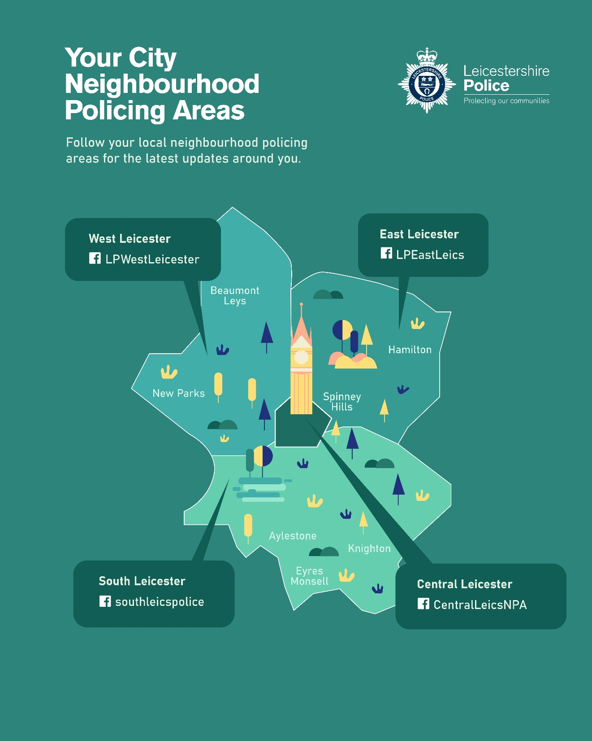
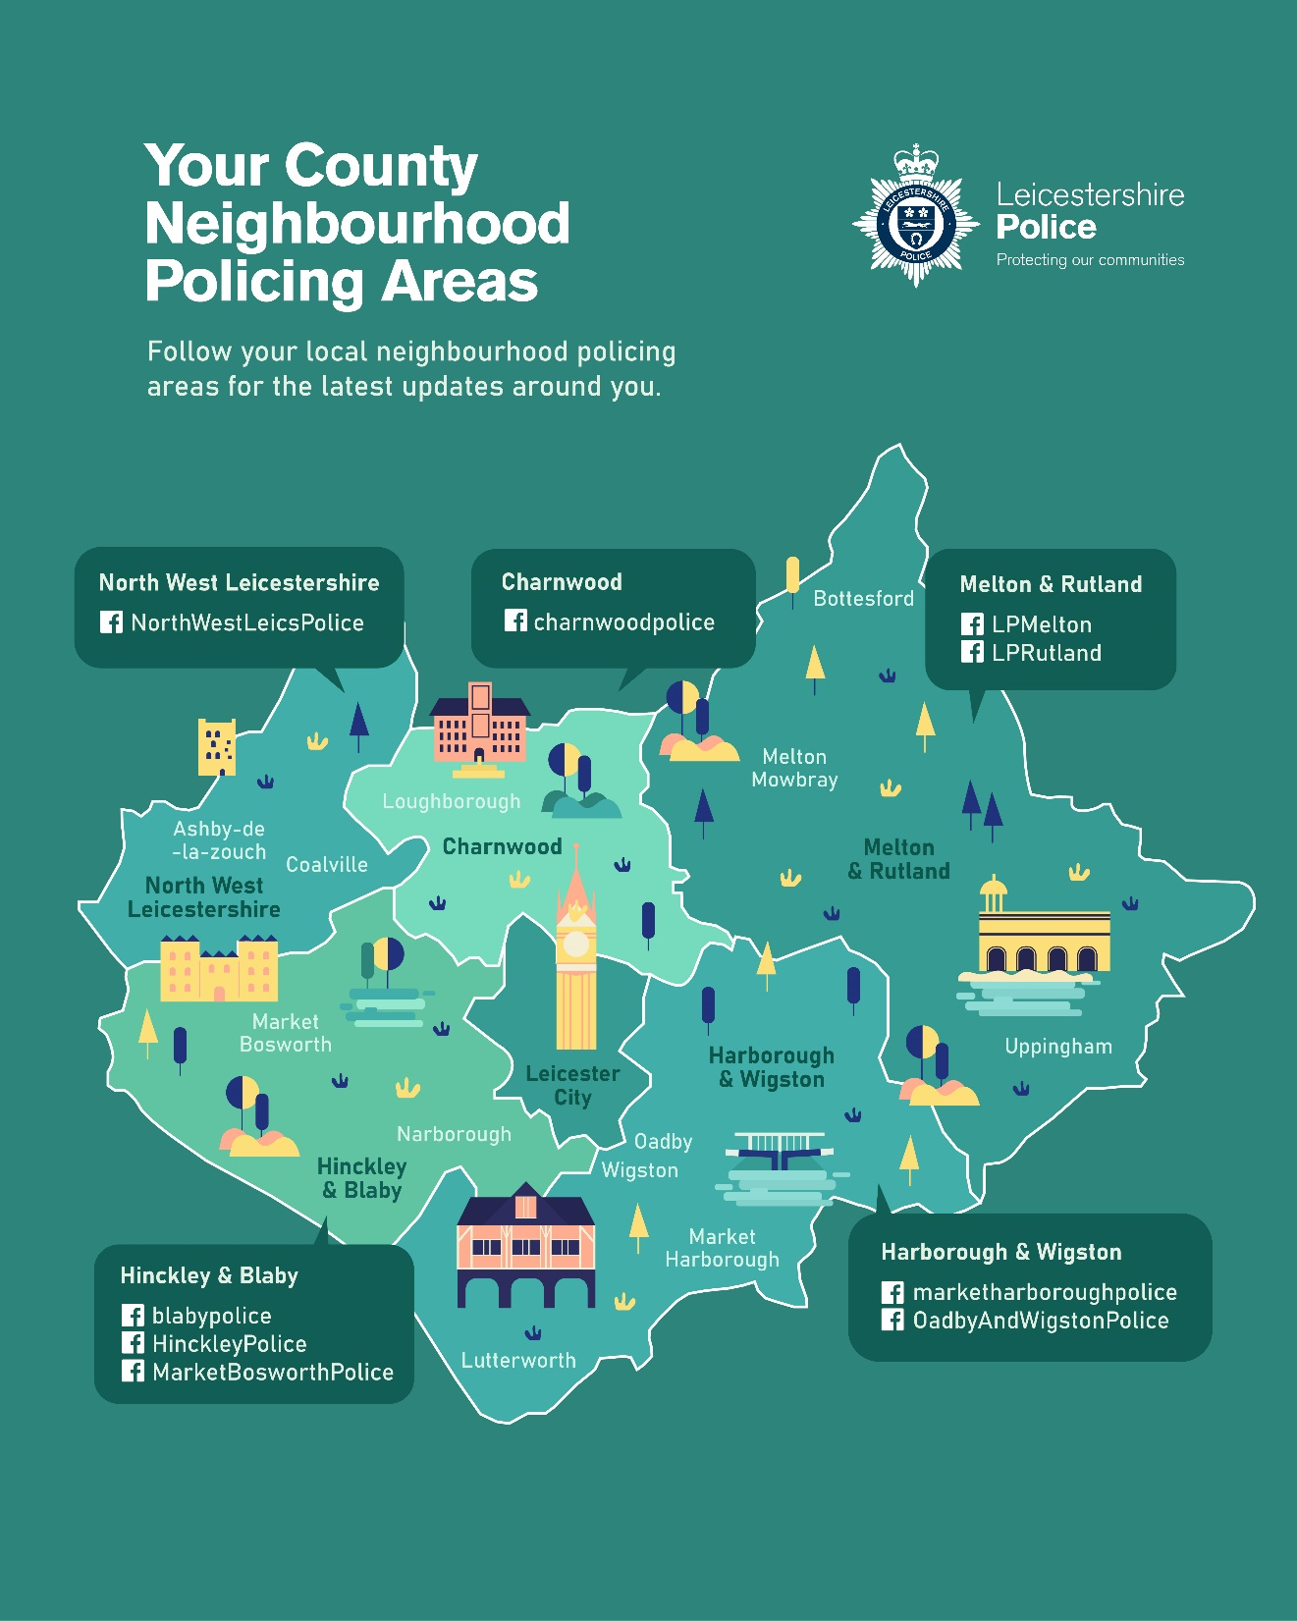

Slide 29

Strategic
Framework

Slide 30
Our strategic framework
Vision
Mission
Values
Pledge, Our Duty, Our Service (Public-facing)
Strategic Priorities 2023
Enabling Strategies (Gold)
High-Level Operational Plans (Silver)
Tactical delivery plans (Bronze)

Slide 31
Vision
What we want to be
A leading force in the country, delivering high quality policing that local people trust.

Slide 32
Mission
Our reason for being and what we do to meet the vision
We are an emergency service. We protect our communities, maintain the peace, prevent and detect crime by working day and night to carry out our duty and our service.

Slide 33
Values
Our behaviours and culture to achieve the mission and vision
Our values underpin our vision and mission. We work as One Team in Leicestershire to embed the College of Policing’s Ethical Policing Principles of:
Courage
Respect and empathy
Public service

Slide 35
Strategic Priorities review 23/24
(What we prioritise as an organisation to deliver the vision and mission)
To meet our vision and mission, we set five strategic priorities in November 2023. They were developed and will be reviewed through the Force Management Statement business processes. We prioritise work against these priorities. They are:
Improving service, raising standards
Finding efficiency and productivity
Developing the right people, right skills and wellbeing
Maximising the best tech we can
Reducing demand through partnership

Slide 36
A comprehensive plan being delivered
Set two years ago, with due regard to Police and Crime Plan
Commitment to re-focus on service and standards
Recognised we needed to invest in digital capability
Agreed to invest in our people, fast track the Academy, leadership development, Occupational Health and wellbeing
Agreed that trust and confidence was our number one priority
Planned and prepared for transformation

Slide 37
Our challenges and transformation agenda
Transformation is complex due to competing and interdependent challenges:
  Increase public and workforce confidence
  Manage increasing and changing demand, enhance our productivity with less resource
  Transform digital services whilst maintaining a complex IT infrastructure
  Make cashable efficiencies to balance the finances across the Medium-Term Financial Plan

Slide 38
Our stakeholders
Chief Constable
PCC
College of Policing
HMICFRS
NPCC
Home Office
Regional partners
Ministry of Justice
Local partners
Federation / Trade Unions
Police and Crime Panel
The people of Leicester, Leicestershire and Rutland

Slide 39
Overview of Enabling Strategies
We deliver high quality police services with high standards that local people trust
Layers 0-5
Executive Group
Improving service and standards
Finding efficiency and productivity
Right people, right skills and wellbeing
Maximising the best tech we can
Reducing demand through partnership
Layer 0
ACC Michaela Kerr
Prevention and Partnerships
Child-Centred Policing
Layer 1
ACC Adam Streets
Public Contact
Layer 2
ACC Adam Streets
Policing in Neighbourhoods
Specialist Operations
Layer 3
ACC Michaela Kerr
Serious Violent Crime
Acquisitive Crime
Vulnerability
Serious Organised Crime
Layer 4
ACC Michaela Kerr
Custody
Prosecutions
Layer 5a
ACO Paul Dawkins
Estates
Finance
Transport
Digital, Data and Technology
Layer 5b
ACO Alastair Kelly
People
Layer 5c
DCC David Sandall
Corporate Services
Professional Standards
Progress reported to:
Executive Group
Date strategy set: Nov 23
Date strategy reviewed: Nov 24

Slide 40
Detect
Improving investigation standards
Op Forefront
Good service
+
High standards
=
Trust
Engage
Strengthening connections with the public
Respect
Strengthening culture, inclusion and conduct
Innovate
Improving impact, efficiency, reducing demand and cost

Slide 41
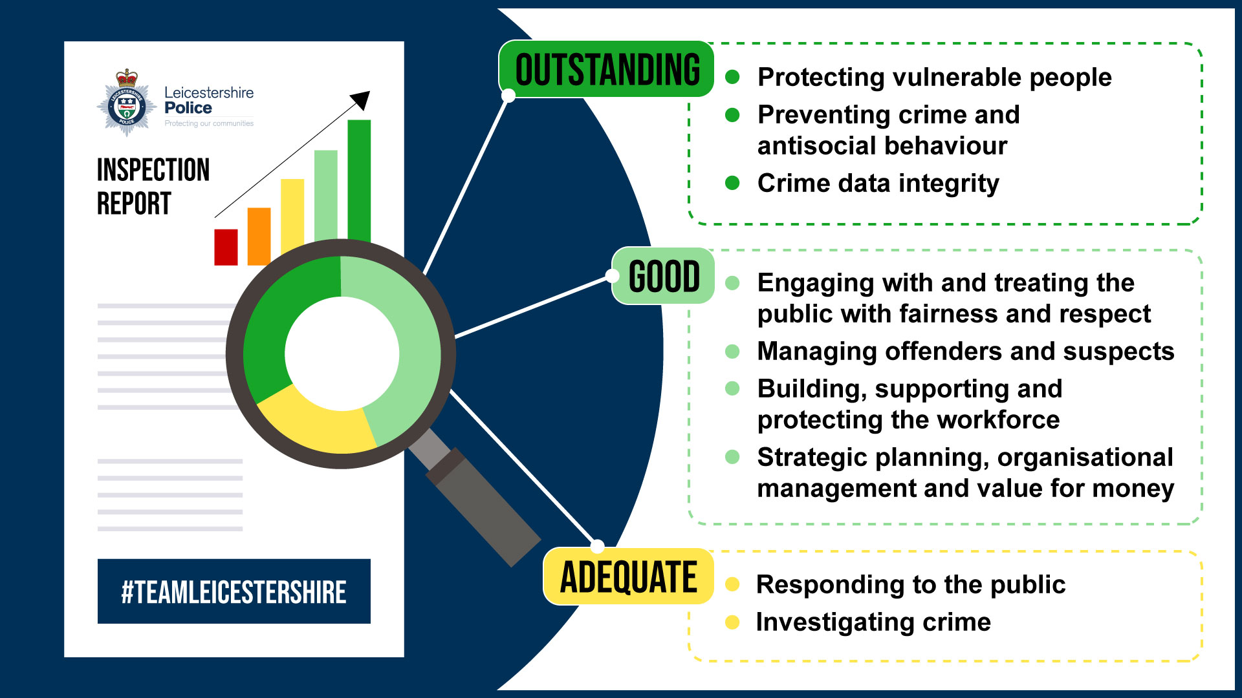

Slide 42
The
Fiscal
Challenge
Kira Hughes, OPCC Chief Financial Officer
Paul Dawkins, Assistant Chief Officer, Finance

Slide 43
The Fiscal Challenge
National budget decisions are impacting on police and partners, specifically resulting in-year and future budget deficits
This is at a time of increased demand and complexity, which requires cashable efficiencies to balance the finances across MTFP, whilst also investment to be made to be able to deliver good public service and high standards, and to retain progress with digitally and technological development
Operational need continues to be at the forefront of the budget-setting process
The challenge is that within the strategic context and the budget challenge the operational delivery and service is paramount, and any further reductions will have a direct impact on our services across Leicester, Leicestershire and Rutland and will affect local Trust and Confidence
Unfair funding for Leicestershire Police, creating a further budget deficit
Notes:
navigating through an unprecedented period of change and faces a multifaceted challenge. This is at a time when confidence in policing nationally and locally has declined, whilst public expectation and accessibility to policing is increasing.

Slide 44
The Fiscal Timeline
Mar. 2022
identified as leading force nationally by HMIC and had a sustainable budget for the entire period of the MTFP, without use of reserves
Apr. 2022
Unfunded in-year pay award of £1900
Sep. 2023
A further only part funded 7% pay award
Apr. 2024
£5.4 million budget deficit for 2024/25
Transformation programme, Operation Forefront
Half the pay agreement for officers was covered by grant, none of the Police Staff pay agreement was covered
£4.8million pay award deficit, continue to rise by £300k year-on-year over the MTFP
Govt grant only covers 77% of the actual cost for Police officers and Staff
£2.3million shortfall, continuing to rise by £400k year-on-year
April 2023
Overcome the budget deficit for 2022/23 and found £3.9mil of sustainable cash efficiency savings
Force assessed as one of the leanest in the country, 81% of the force budget invested in people
December 2023
Budget announcement
Leicestershire Police unfunded again
Leicestershire Police is one of 18 of the 43 police forces that is detrimentally
impacted upon through being awarded a lower grant

Slide 45
Three-year budget challenge 2023-2026
Budget funding gap: £3.9m in 2023/24 Achieved and exceeded
£5.4m in 2024/25 (plus 6% vacancy = £8.6m)
£4.8m in 2025/26 (based on current assumptions)
Strategic approach
Year 1 Manage cash flow while setting foundations
Year 2 & 3 Transformation to maintain service and realise efficiencies
Central government funding will not meet what we need
Already leading the way with lean “back office”
Officer numbers locked in: 2242 in March (head count of 2298). First measure point passed; next one Sept 2024

Slide 46
Budget deficit plan - Workstreams
Non-pay base budget savings
Non-cashable efficiencies: target of 200,000 hours.
Pay workstream: Establishment review conducted. Vacancy controls and procedures in place with single oversight. Recruitment pipeline paused (completed). Voluntary Redundancy opened for four weeks.
Income generation

Slide 47
Digital Landscape: Complexity of Crime
Force

Slide 48
The Digital Landscape
The importance of digital investment and delivery to manage demand and find efficiencies has continued to be very high.
The pace of technology and in particular an explosion of data has placed pressure on the force digital capability
Enabler
Key requirement to deliver policing
Prioritising and availability of key skills in information technology
Our data collection is substantial and places pressures on our IT infrastructure, prompting a digital and technology enhancement program to optimize AI, data analysis and storage.

Slide 49
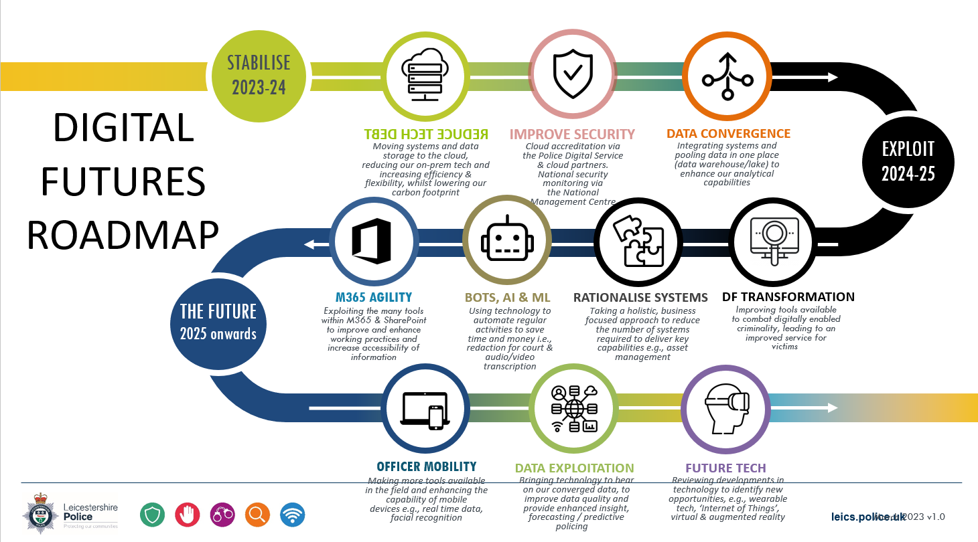

Slide 50
Trust and Confidence: Working together
Claire Trewartha, Chief Executive
Chris Kealey, Force Head of Communications

Slide 51
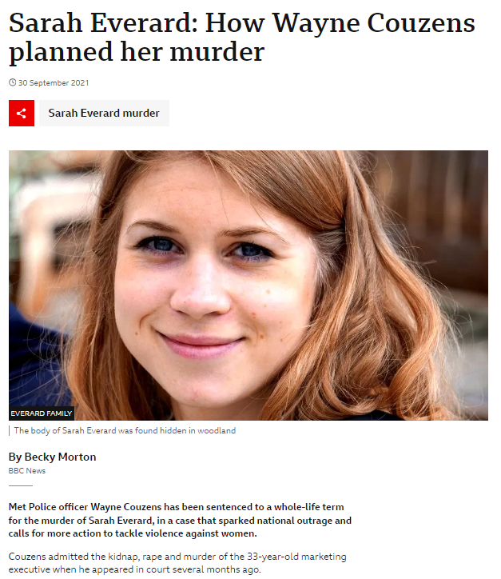
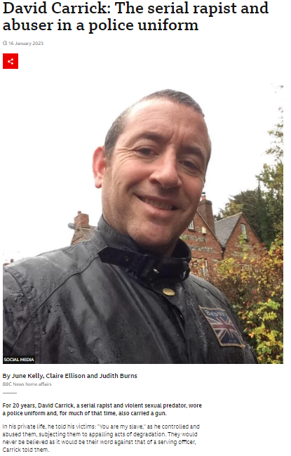
Trust and Confidence
The overall aim is to strengthen trust and confidence by delivering a good service through high standards
Trust and Confidence within policing is at an all-time low
There are several external factors affecting the public's trust and confidence in policing such as;
  A number of high-profile cases that damage the reputation of the police
  Raised expectations of the public on the police and the expectation of the police service’s ability to deliver
  The Casey review has impacted the public’s perception of the Police
Delays in the Local criminal justice system has significantly challenged the delivery of core police activity

Slide 52
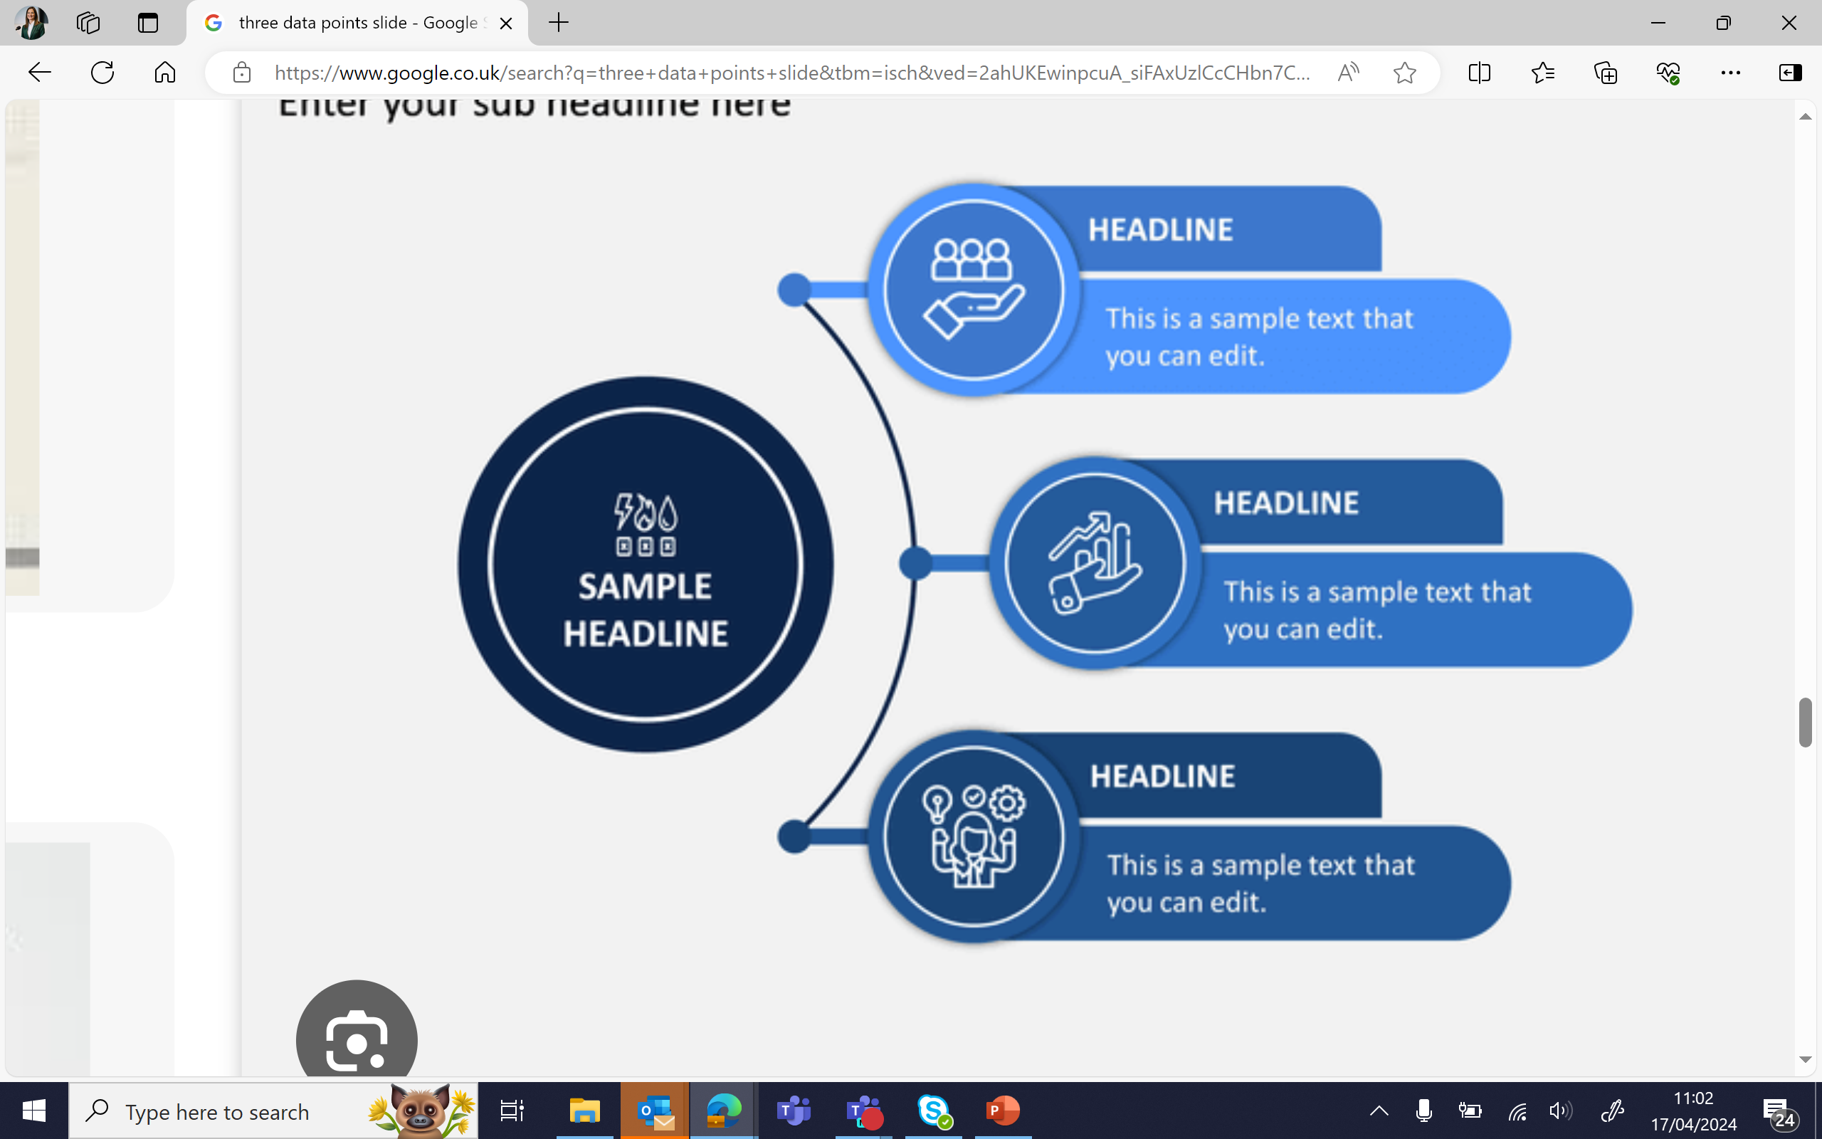

Trust and Confidence
60.1%
Of people have confidence in the Force
45%
Of people think the Force are dealing with crime
Approx 1400
Complaints made in the last 11 months

Slide 53








Consultation with most affected groups/age ranges to gather insight which will shape service delivery
Trust and Confidence
Actively Promoting the work of the OPCC independent scrutiny panels.
Internal confidence surveying by the force via the Telephone Research Bureau.
Support the PCC in conducting surveys of communities
Engagement across the community by multiple means
Implementing the National Police Race Action Plan.
Assisting the realisation of the ‘Chiefs Pledge’.
Working closely with internal Networks.

Slide 54
Engagement with communities
  24 / 7 / 365 on-call communications supporting operational policing
  51 social media channels. 4 central and 47 local, mirroring local police areas
  Neighbourhood Link e-mail update and survey c.43k users
  Local beat priorities updates on our website #YouSaidWeDid
  Engagement standards set for surgeries, parish council meetings etc, newsletters and local updates
  Survey regime to evaluate and learn

Slide 55


Slide 56
Questions?

